Slide 1
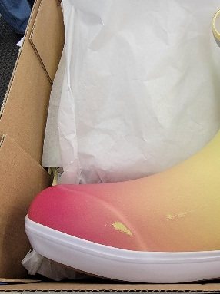

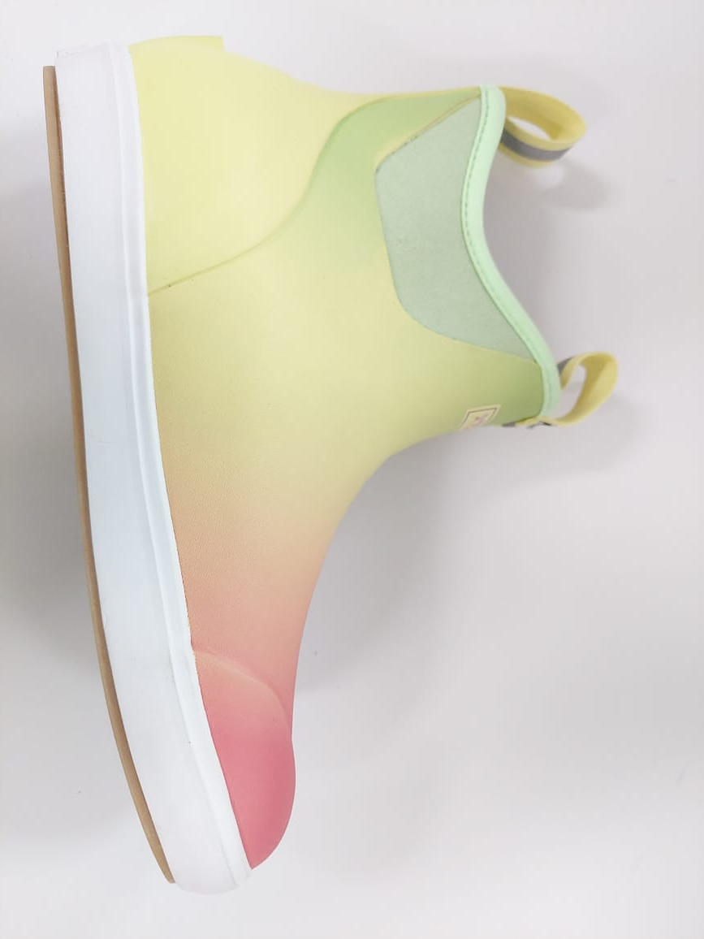
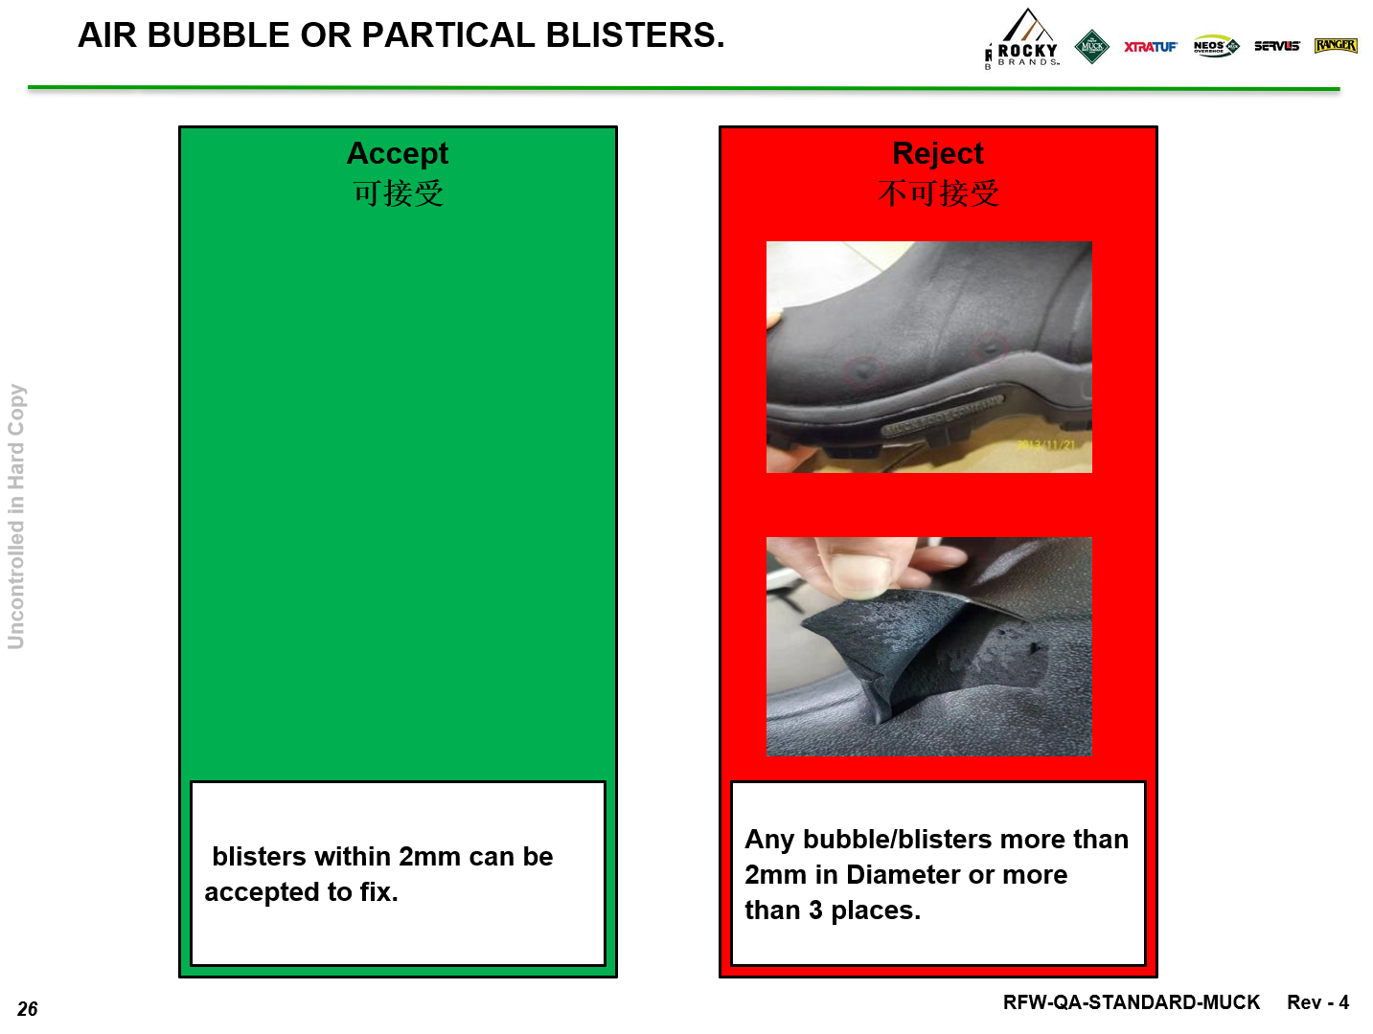
Quality issue: Damage Printing
PROBLEM DESCRIPTION (quality issue: 8D, Factory, Shipped Pos / Best practice: DMAIC) |  | VISUALIZED PROBLEM (photos BEFORE vs AFTER)
#Damage Printing
Root Cause (finishing root cause)
Corrective Action
LESSON LEARNED (quality issue) or RECOMMENDATION (improvement) |  | STANDARDIZATION (process/tool/pokayoke) or VALIDATION (DPPM graph, cost saving graph, etc…)
Before
Improvement
Background : Damage Printing in toe cap area
Process Repair (Finishing) :
Cleaning Proces use Xylene/MEK
Contamination glue on Printing
Preventive Improvement at Finishing Line process
Make sure finishing is free from MEK
Becareful When handling
Use pure checmical 233 BF
Scractch don’t use whiteboard marker
Chemical Identity must be clear. When not use at finishing area,
Laboratory Departement must to withdraw the chemical
Digital Printing
Standardization :
Temperature machine doubling = 1-2 (45-50C), 3-4 (40-45C), 5-6 (50-55C)
Thickness STD 1.35-1.4
Speed Ave (20-30 RPM)
Mixing compound rubber = 75% Original : 25% Scrap
Improve Quality standard for bubble/pitting/pin hole from 2mm to be 0mm
QC check 100% toe cap area, keep to ensure no issue damage printing
STD from Rocky
Assembling & Finishing (Recommendation to Improvement):
Repair Handling, Flow Chart & PIC Repair must direct to Line & Check QC
Repair Cleaning -> Drying -> Direct to finishing Line (Don’t pack right away)
Closing PO
Re-training & Make clear checkpoint quality inspection in QC finishing line with visual and standardization
Under control QC Auditor keep to ensure process follow SOP

